Slide 1
Installation

Slide 2
ISO file
Single File
Perfect Representation of CD/DVD

Slide 3
Bootable USB Stick
Rufus
Yumi
PowerISO

Slide 4
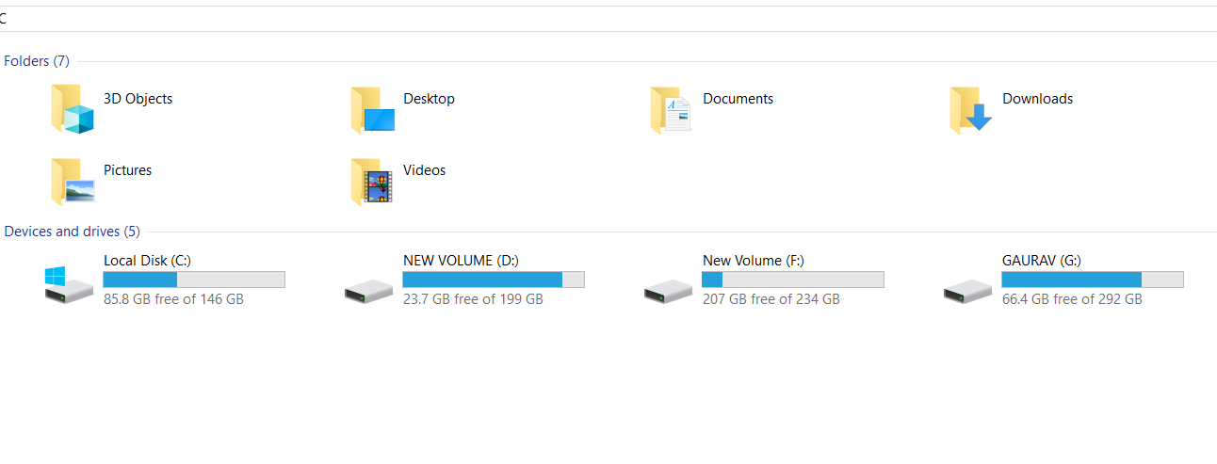
Disk Partitioning

Slide 5
Types of partitions
Primary Partition
Extended Partition
Logical Partition

Slide 6
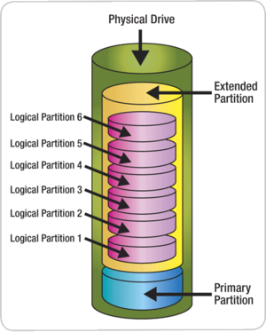
Disk partitions

Slide 7
Partitioning Scheme
MBR (Master Boot Record)
GPT (GUID Partition Table)

Slide 8
MBR vs GPT
Master Boot Record
Only 4 primary Partitions
Support volume up to 2TB
GUID Partition Table
Up to 128 partitions
Support up to 9 million TB

Slide 9
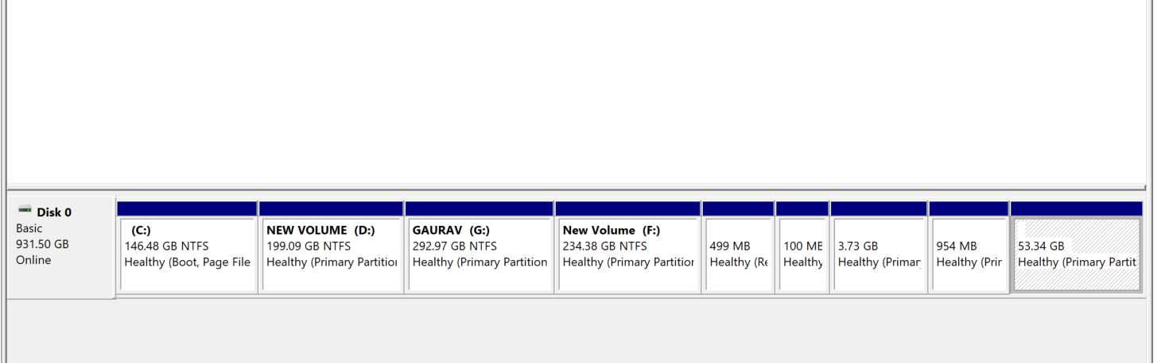
GPT Partition Scheme

Slide 10
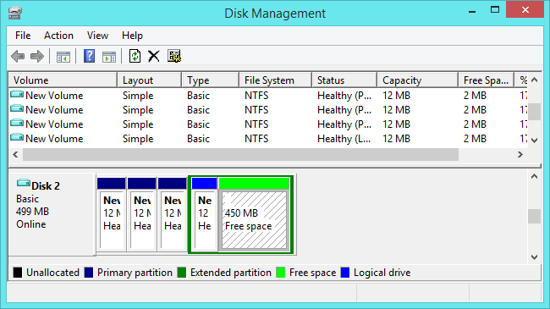
MBR Partition Scheme

Slide 11
UEFI vs Legacy

Slide 12

Let’s start Installation
Notes:
12

Slide 13
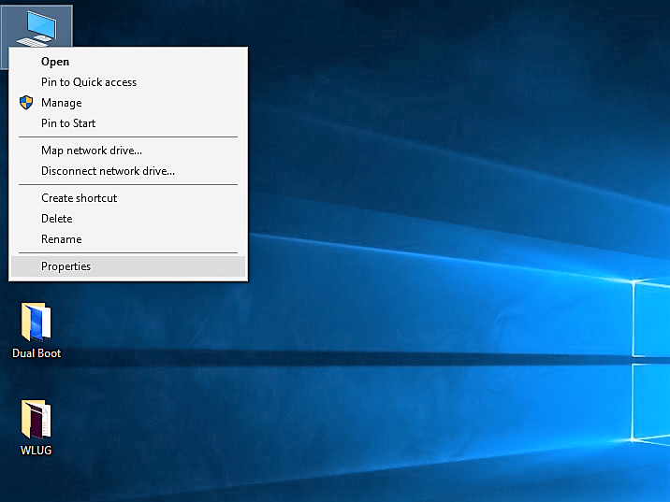
Windows Product ID
Right Click on
This PC and
Properties

Slide 14
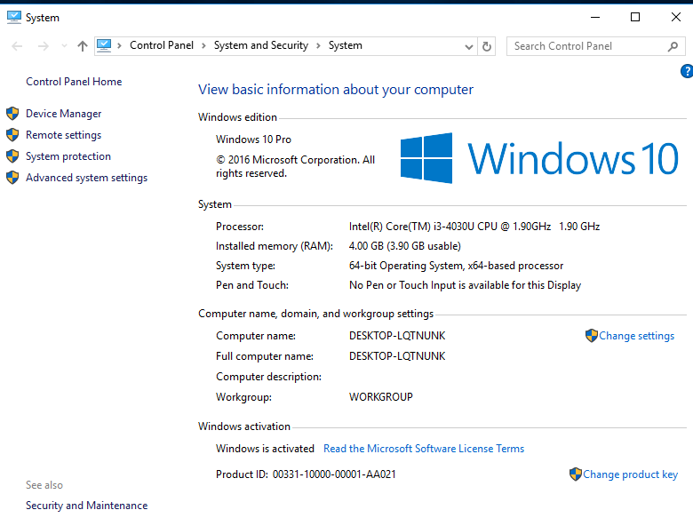
Note down the
Product ID

Slide 15
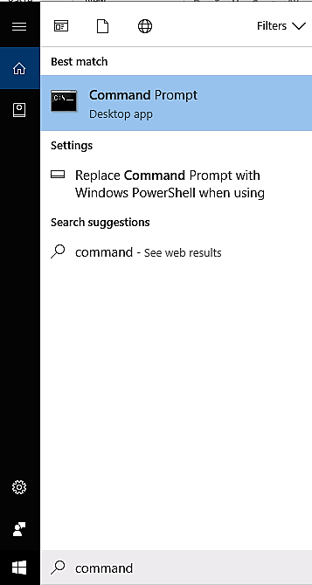
Partition Scheme: MBR or GPT ?
Command Prompt

Slide 16
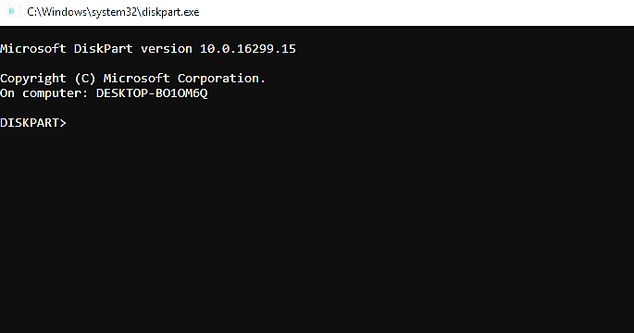

Slide 17
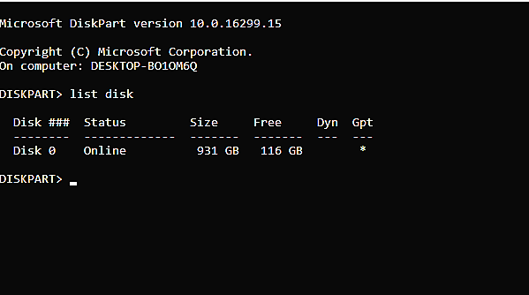
GPT

Slide 18
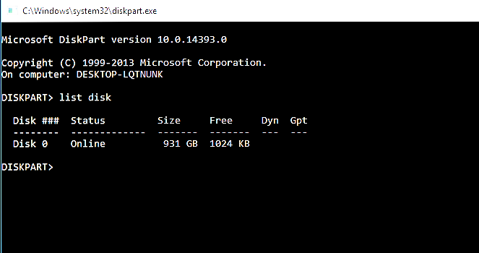
MBR

Slide 19
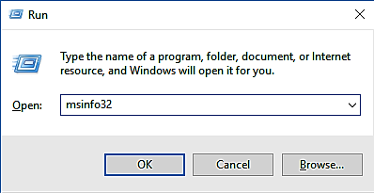
BIOS Mode : UEFI or Legacy ?
Windows + r

Slide 20
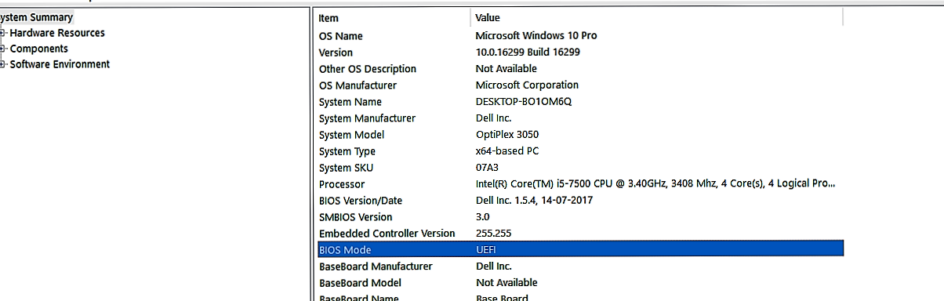
UEFI

Slide 21
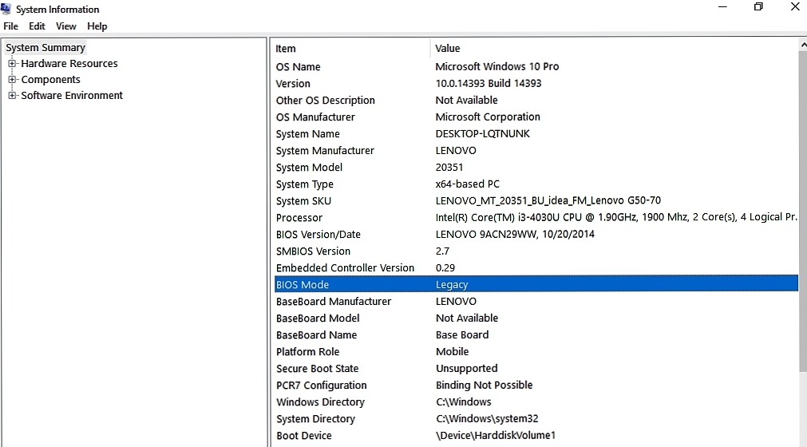
Legacy

Slide 22
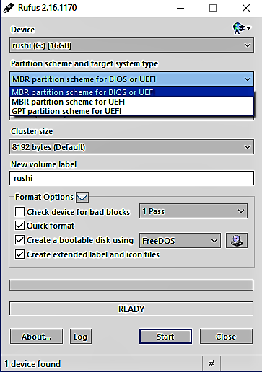
Bootable Disk
Open Rufus

Slide 23
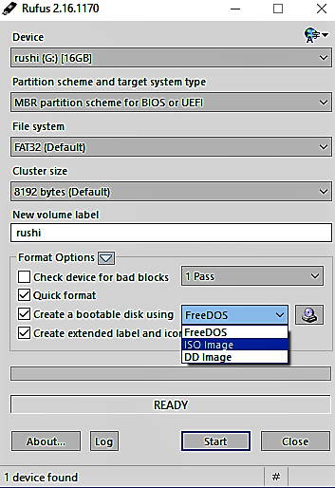
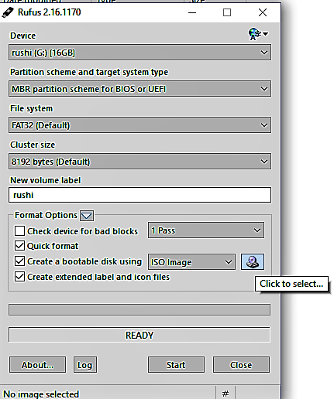

Slide 24
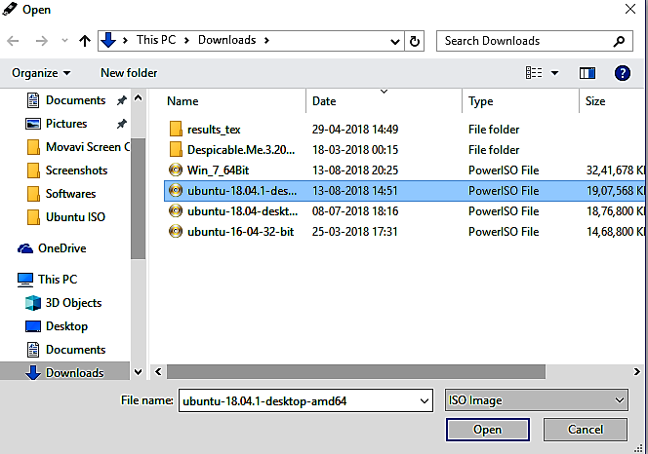
Browse the ISO Image

Slide 25
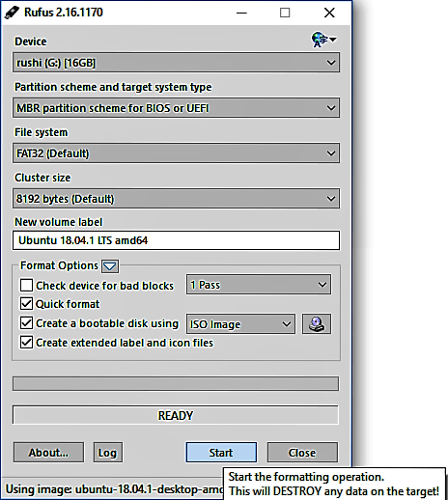
Click on Start

Slide 26
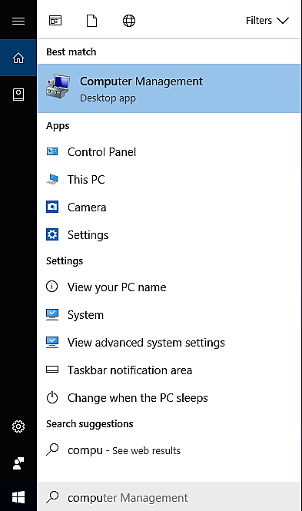
Disk Partition
Computer Management

Slide 27
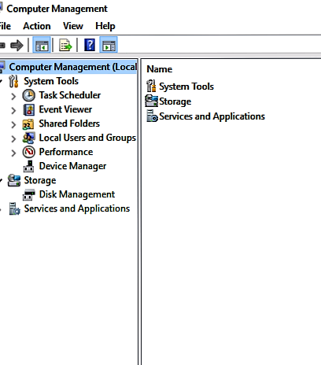
Click on Disk Management

Slide 28
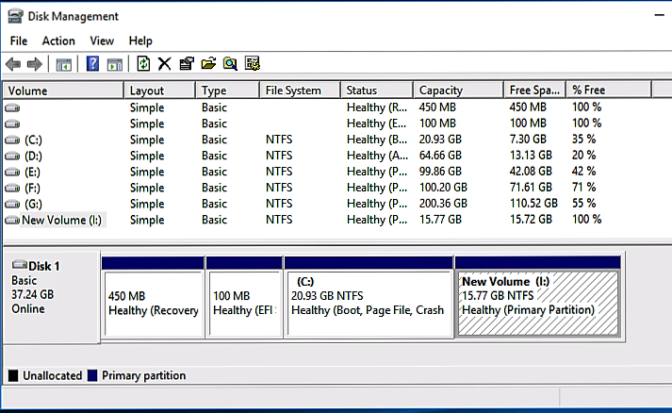
For GPT
Right Click on Drive
and Click on Shrink
Volume

Slide 29
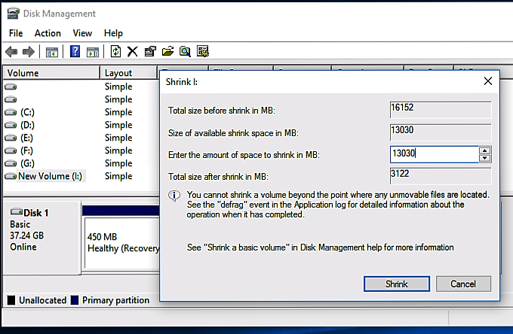
Shrink The Volume

Slide 30
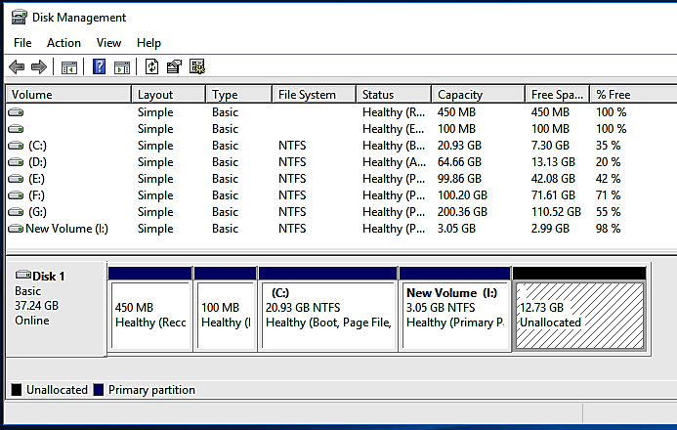

Slide 31
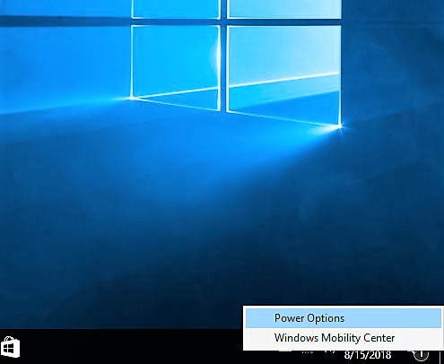
Fast Start Up
Right Click On Battery Icon
Select Power Options

Slide 32
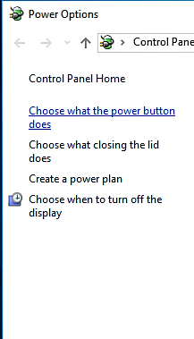
Click On
–Choose what the Power button does

Slide 33
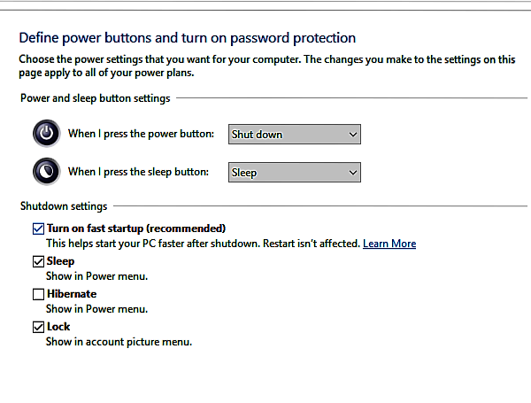
Un-tick the Fast Startup
Option
Click on Save Changes
Close The Window

Slide 34
Check For Bootable PD
If Completed , click on Close.
Re-Start the System

Slide 35
Keys
Company | BIOS Key | Boot Key
HP | F10 or Esc | F12 or Esc
DELL | F12 | F12
LENOVO | F2 | F12
ASUS | Esc | F9 or F8
ACER | F2 | F12

Slide 36
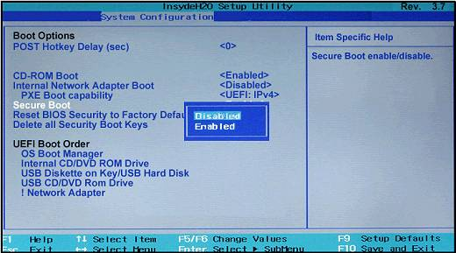
Secure Boot-OFF
Press BIOS Key
Go to System Conf.
Secure Boot
Click On Disables
Exit (Press F10)

Slide 37
Installation
Press Boot Key
Select Bootable Device (Your PD Name)

Slide 38
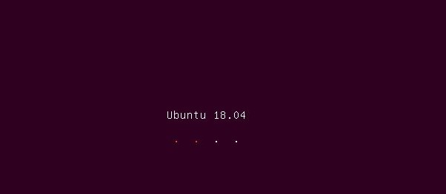

Slide 39
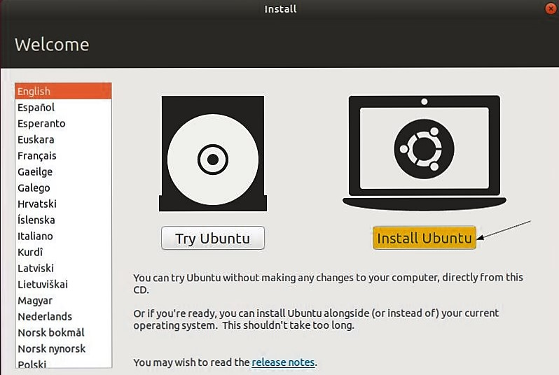
Click on Install Ubuntu

Slide 40
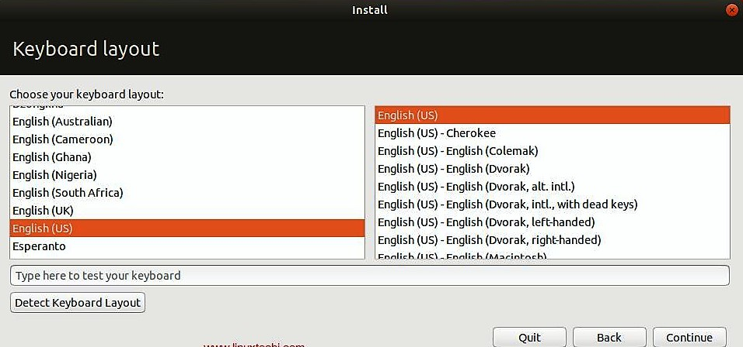
Select English And Click On Continue

Slide 41
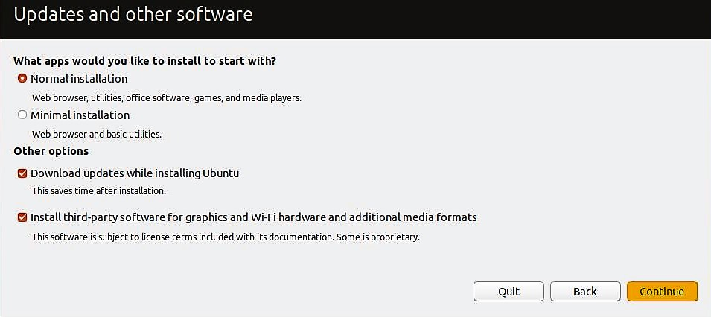
Un tick Last Two Options
And
Click on Continue

Slide 42
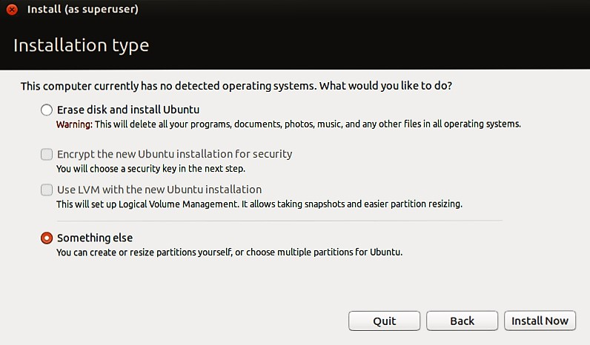
Select – Something else and
Click on Install Now

Slide 43
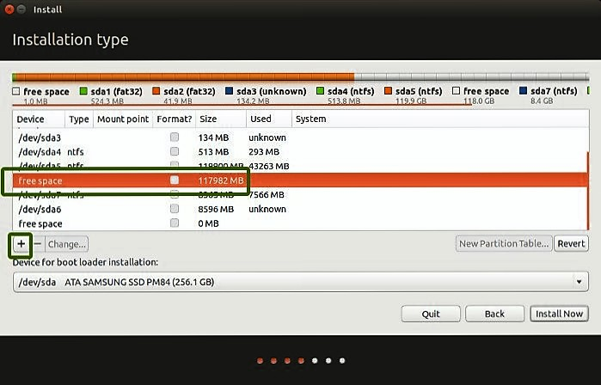
Select Free Space & Click on ‘+’

Slide 44
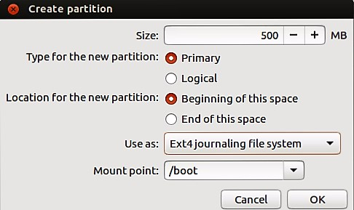
Boot Space
De-Select Primary
and
Select Logical
Click on OK

Slide 45
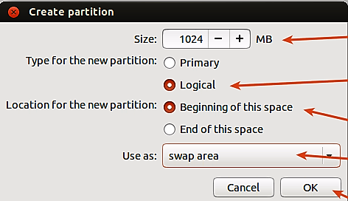
Swap Area
Click on OK

Slide 46
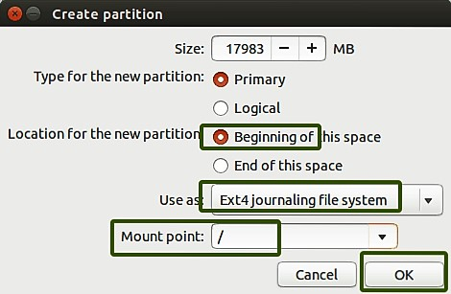
Root (/)
Click on OK

Slide 47
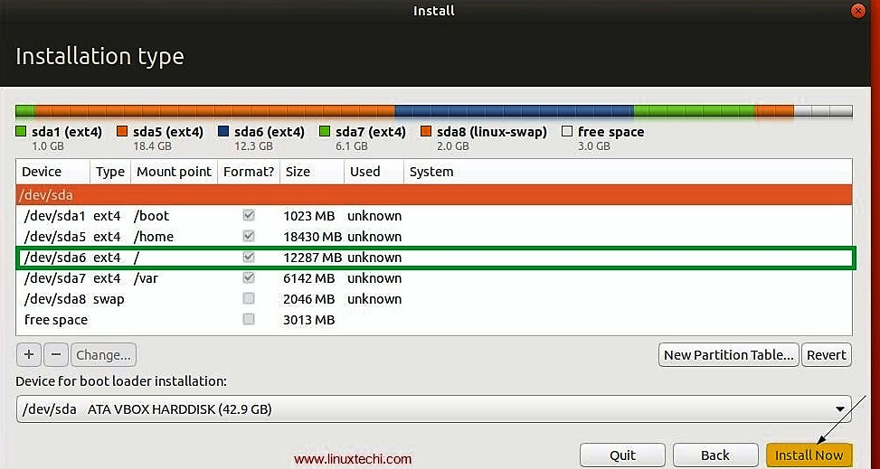
Select Root(/) And Then Click on Install Now

Slide 48
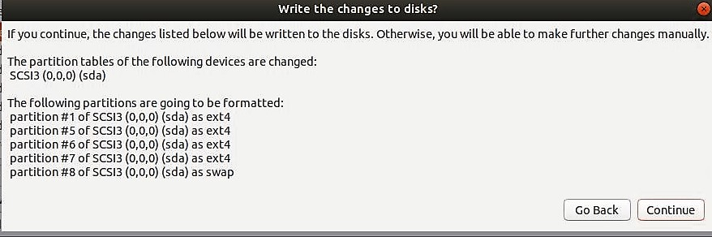
Click On Continue

Slide 49
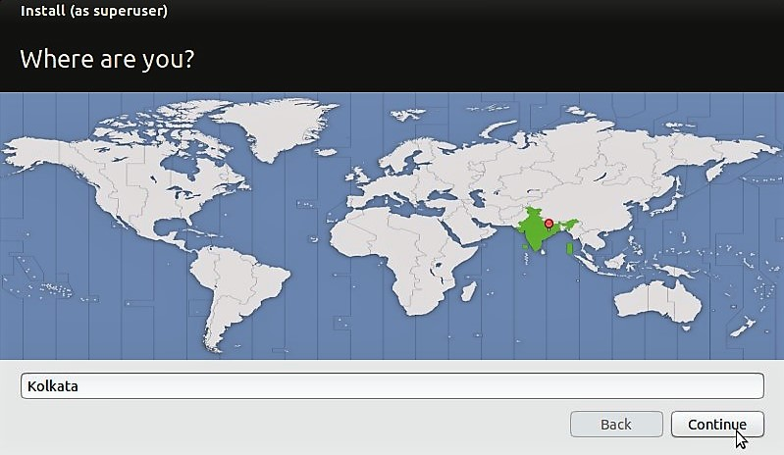
Select India & Click on Continue

Slide 50
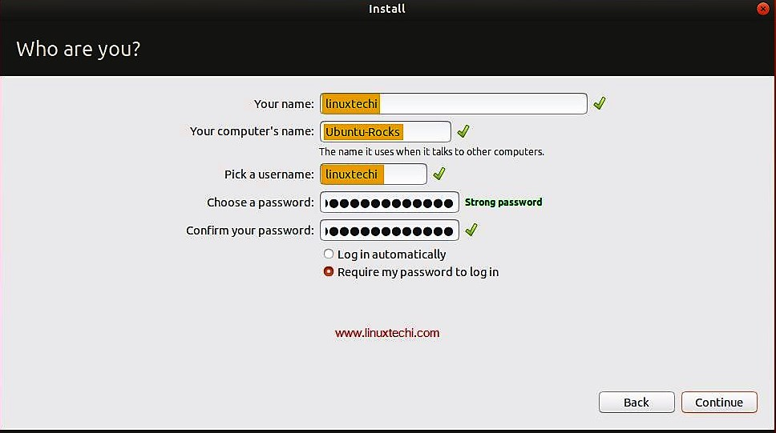
Set Your PC Name & Password

Slide 51
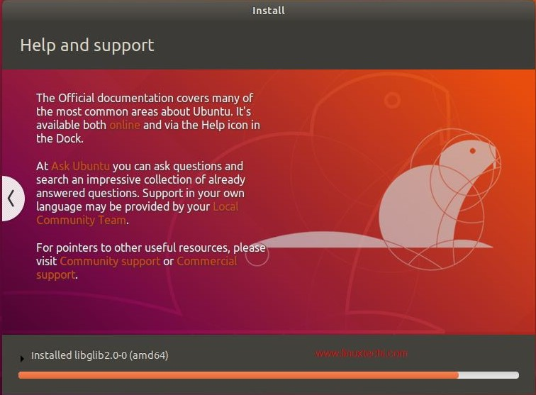
Installation Process Started

Slide 52
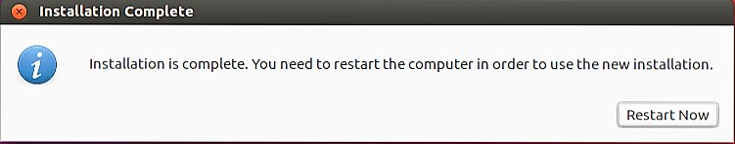
Installation Completed
Click on Restart Now & Remove The Pen Drive

Slide 53
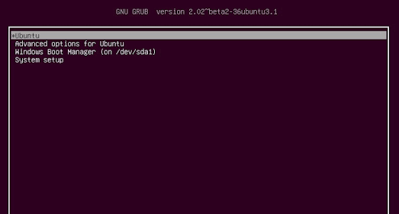
Select Ubuntu & Press Enter

Slide 54
Done With Installation

Slide 55
Install updates
Open terminal using ctrl+alt+t
sudo apt-get update
sudo apt-get upgrade
Notes:
55

Slide 56
Install Important softwares
sudo apt-get install gnome-tweaks
sudo apt-get install gcc
sudo apt-get install g++
sudo apt-get install vlc
Notes:
56

